Slide 1
Distributed Systems
Distributed
Web-Based Systems
Chapter 12

Slide 2
Course/Slides Credits
Note: all course presentations are based on those developed by Andrew S. Tanenbaum and Maarten van Steen. They accompany their "Distributed Systems: Principles and Paradigms" textbook (1st & 2nd editions).
http://www.prenhall.com/divisions/esm/app/author_tanenbaum/custom/dist_sys_1e/index.html
And additions made by Paul Barry in course CW046-4: Distributed Systems
http://glasnost.itcarlow.ie/~barryp/net4.html

Slide 3
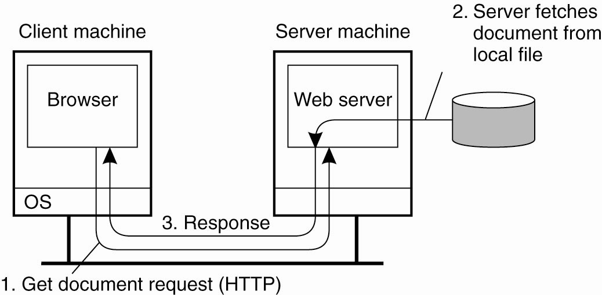
Traditional Web-Based Systems
The overall organization of a traditional Web site

Slide 4
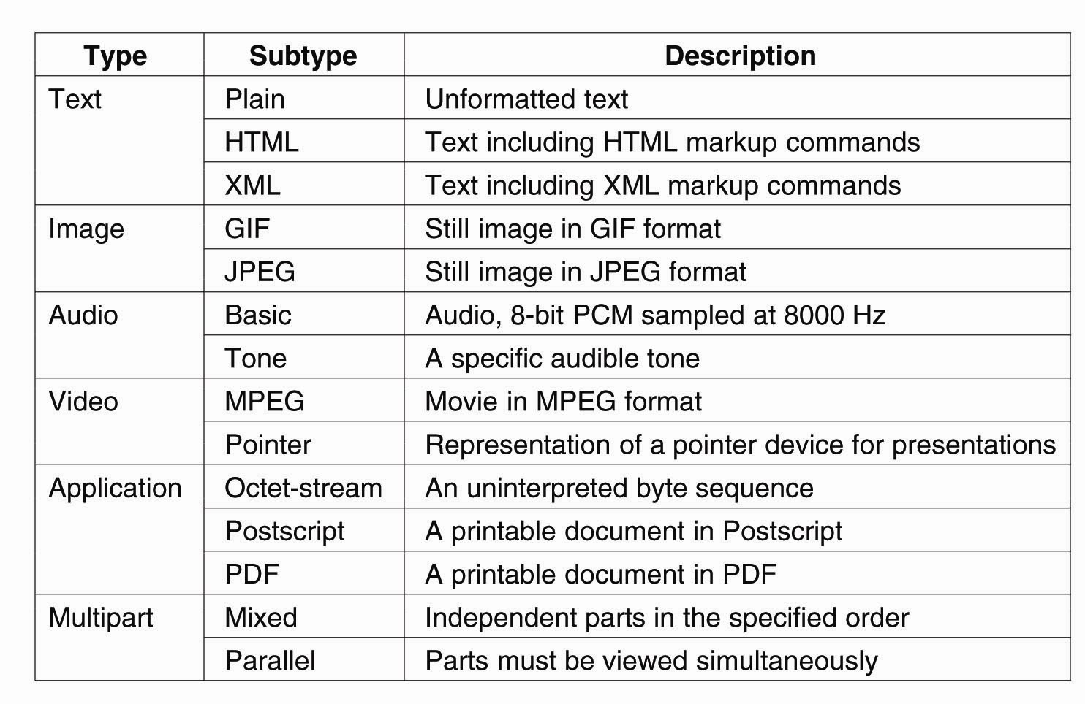
Web Documents
Six top-level MIME types and some common subtypes

Slide 5
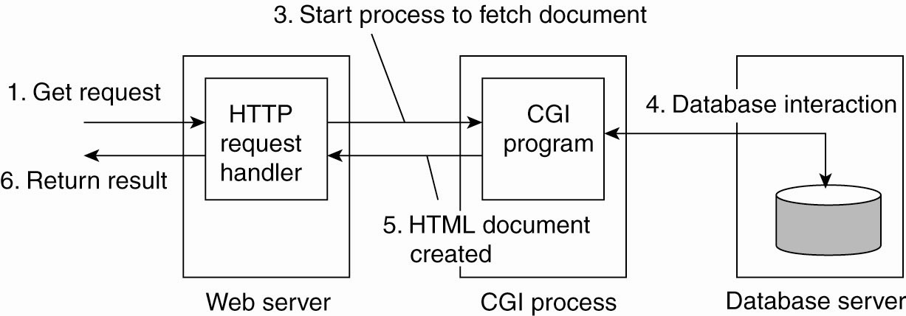
Multitiered Architectures
The principle of using server-side CGI programs

Slide 6
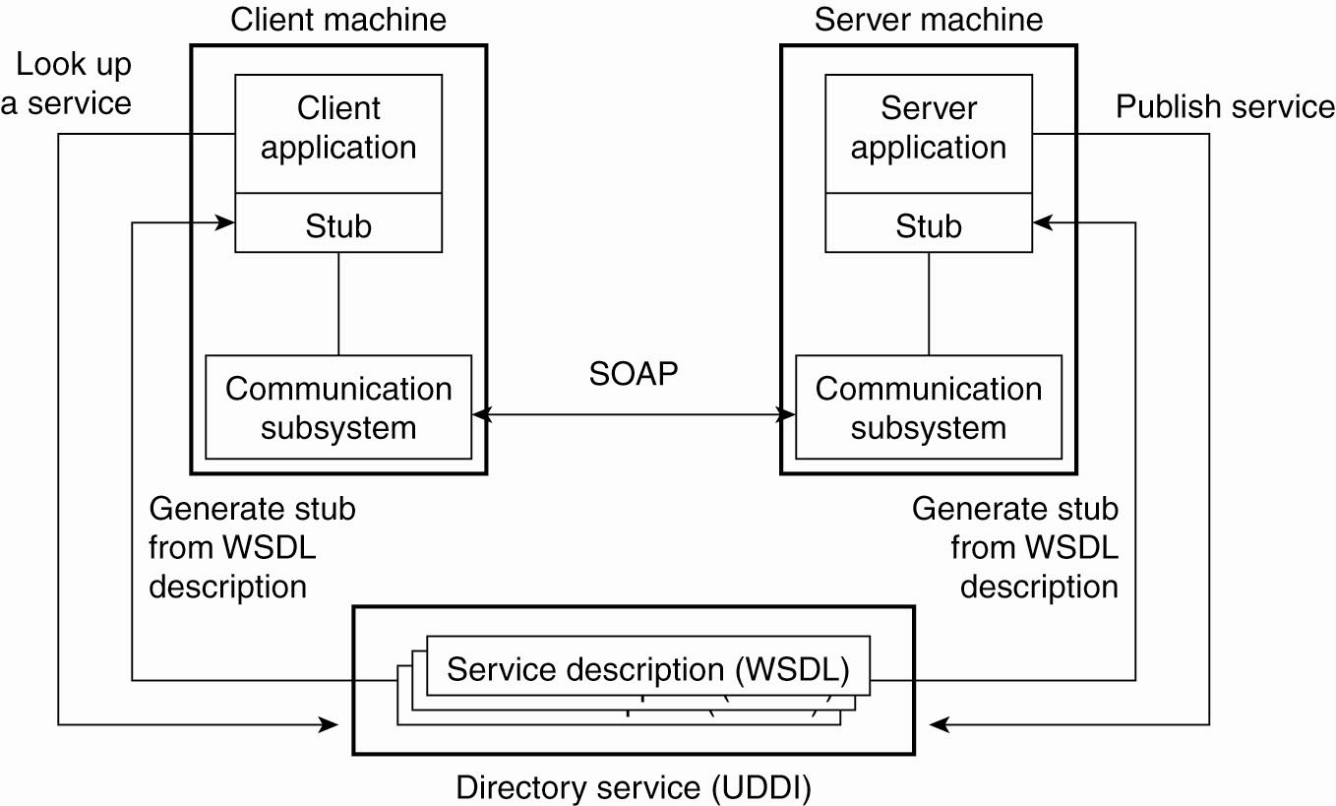
Web Services Fundamentals
The principle of a Web service

Slide 7
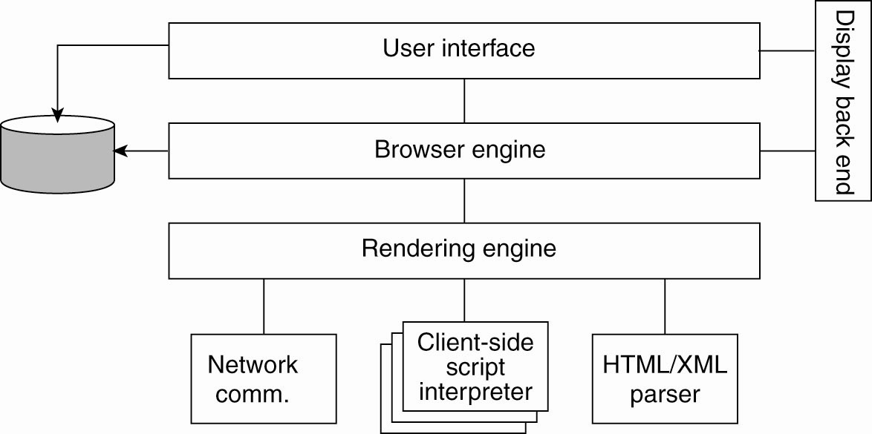
Processes – Clients (1)
The logical components of a Web browser

Slide 8
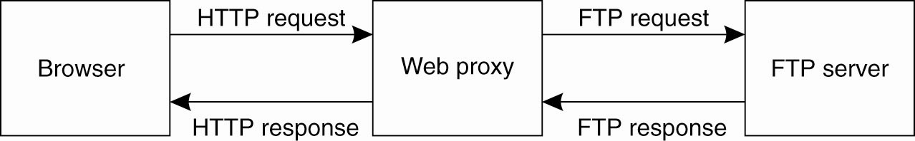
Processes – Clients (2)
Using a Web proxy when the
browser does not speak FTP

Slide 9
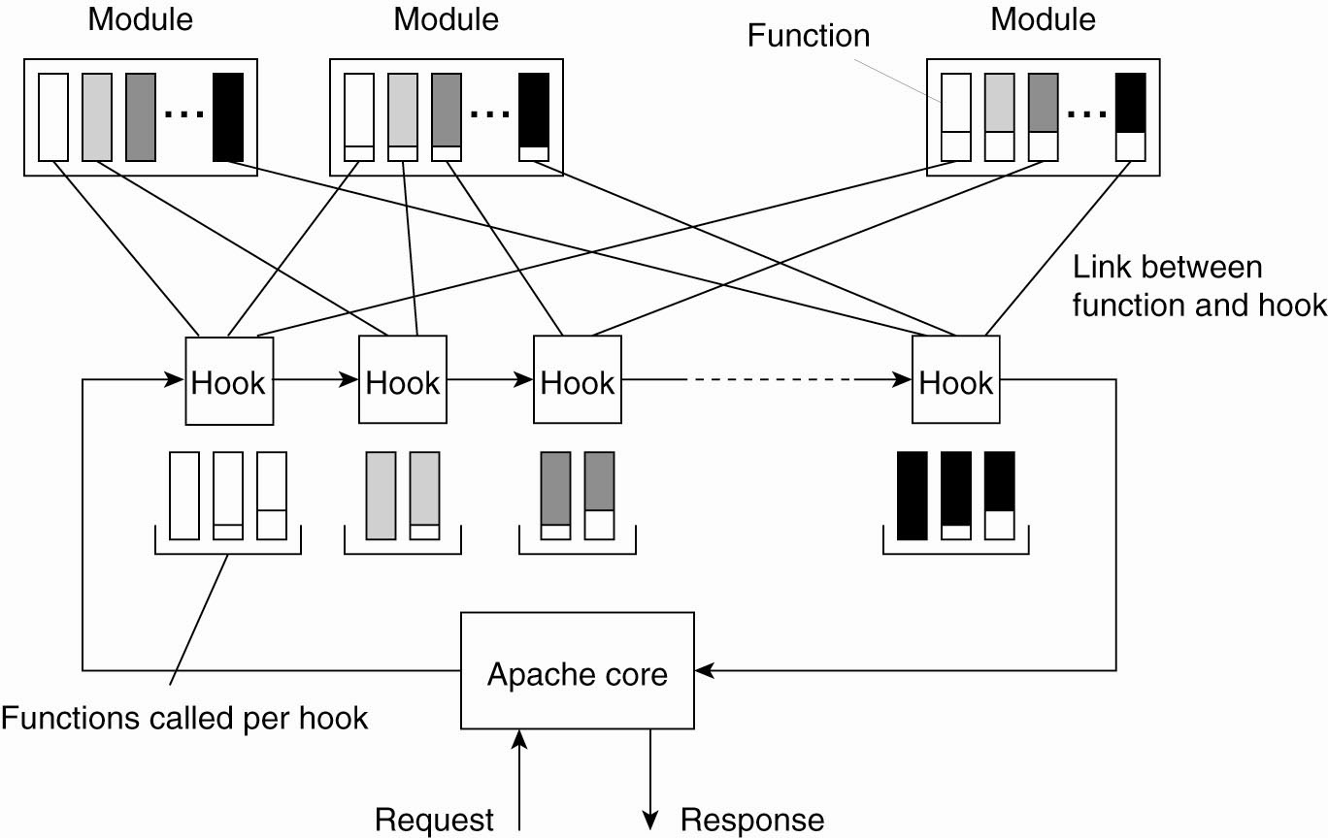
The Apache Web Server
The general organization of the Apache Web server

Slide 10
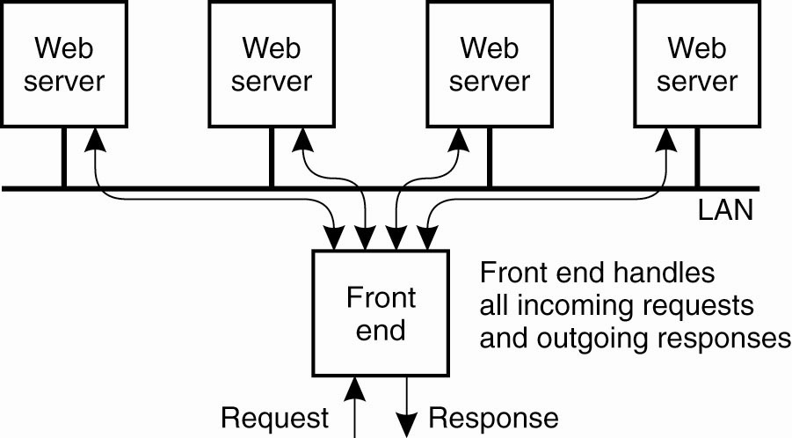
Web Server Clusters (1)
The principle of using a server cluster in combination with a front end to implement a Web service

Slide 11
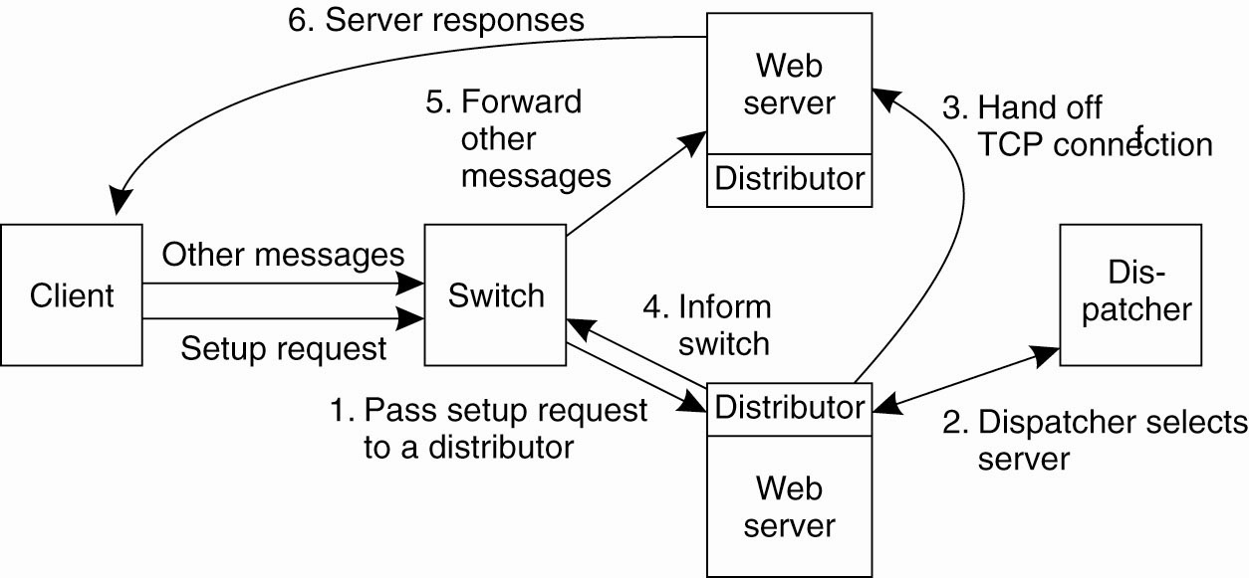
Web Server Clusters (2)
A scalable content-aware cluster of Web servers

Slide 12
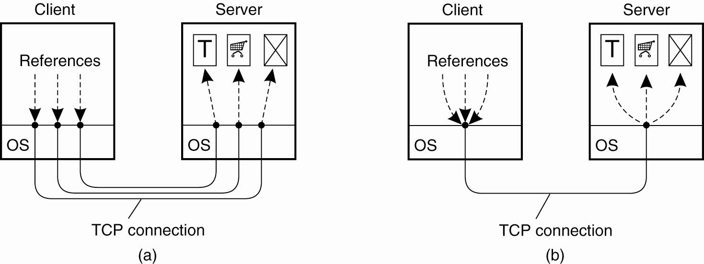
HTTP Connections (1)
(a) Using non-persistent connections

Slide 13
HTTP Connections (2)
(b) Using persistent connections

Slide 14
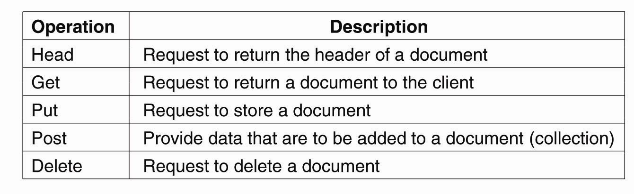
HTTP Methods
Operations supported by HTTP

Slide 15
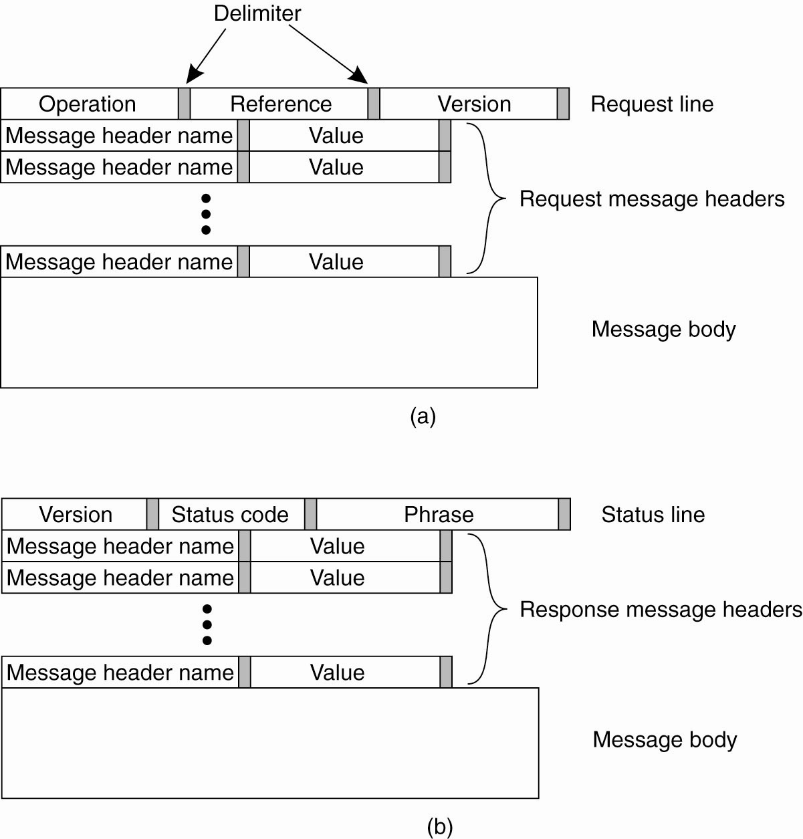
HTTP Messages (1)
(a) HTTP request message

Slide 16
HTTP Messages (2)
(b) HTTP response message

Slide 17
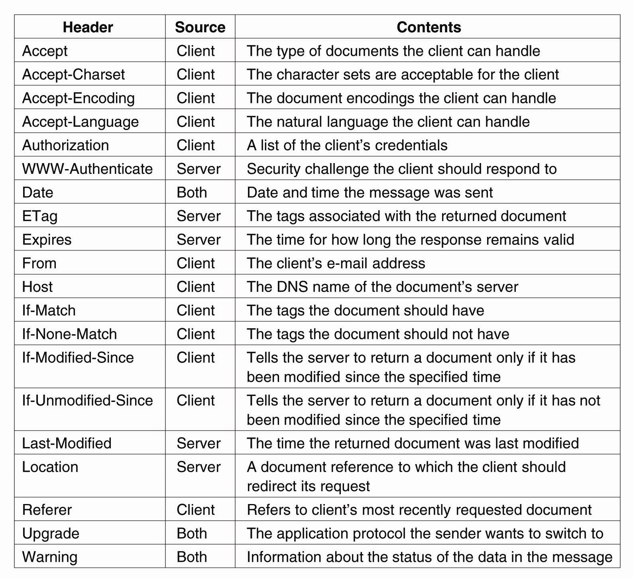
HTTP Messages (3)
Some HTTP message headers

Slide 18
HTTP Messages (4)
Some HTTP message headers

Slide 19
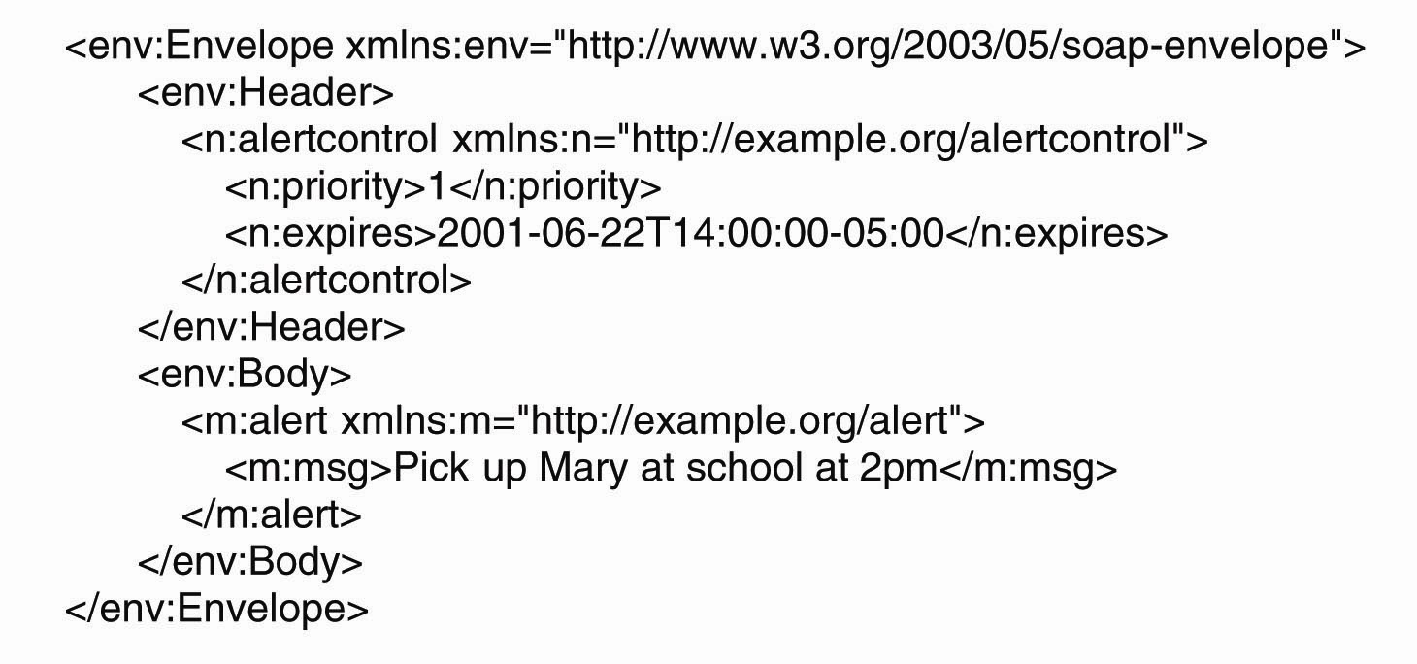
Simple Object Access Protocol
An example of an XML-based SOAP message

Slide 20
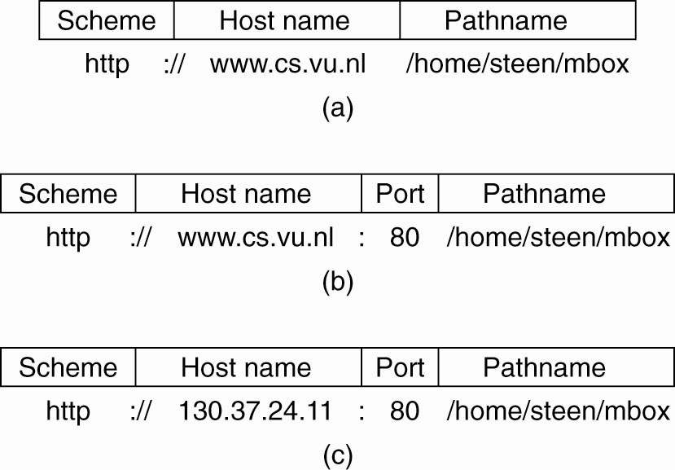
Naming (1)
Often-used structures for URLs. (a) Using only a DNS name. (b) Combining a DNS name with a port number. (c) Combining an IP address with a port number.

Slide 21
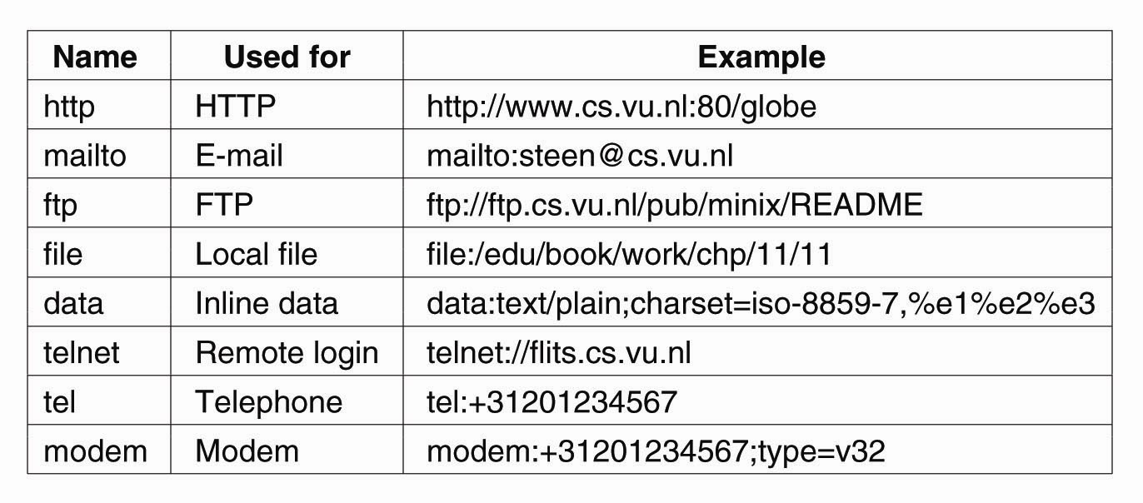
Naming (2)
Examples of URIs

Slide 22
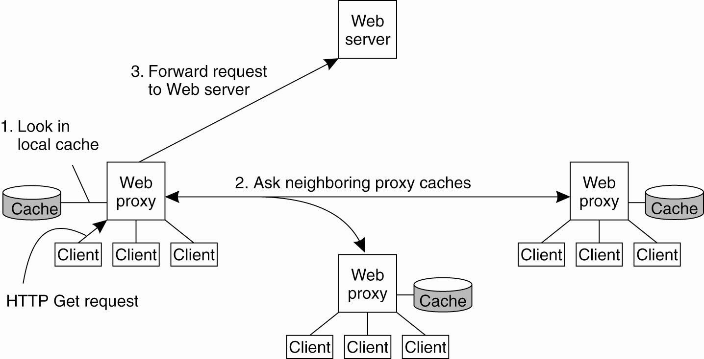
Web Proxy Caching
The principle of cooperative caching

Slide 23
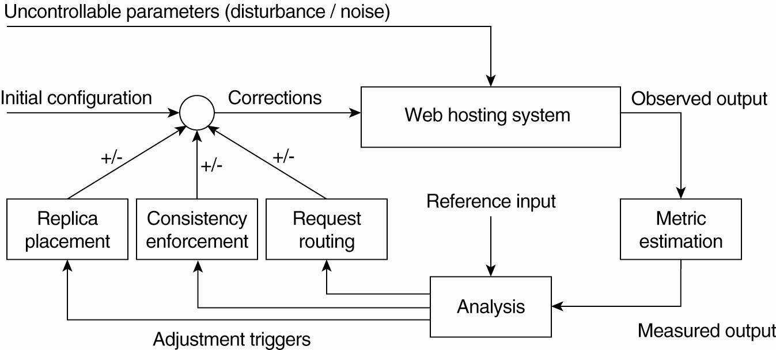
Replication for Web Hosting Systems
The general organization of a CDN as a feedback-control system (adapted from Sivasubramanian et al., 2004b)

Slide 24
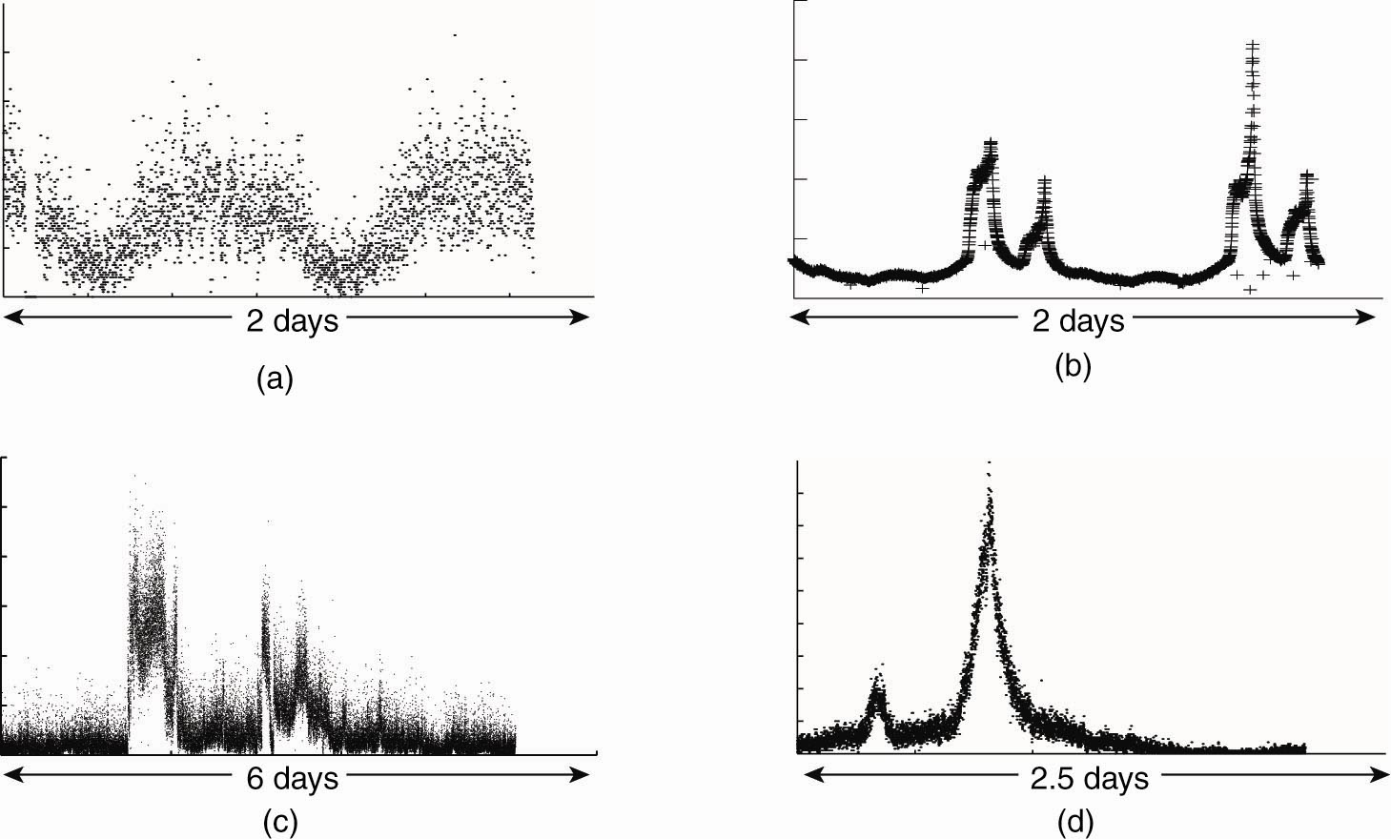
Adaptation Triggering
One normal and three different access patterns reflecting flashcrowd behavior
(adapted from Baryshnikov et al., 2005)

Slide 25
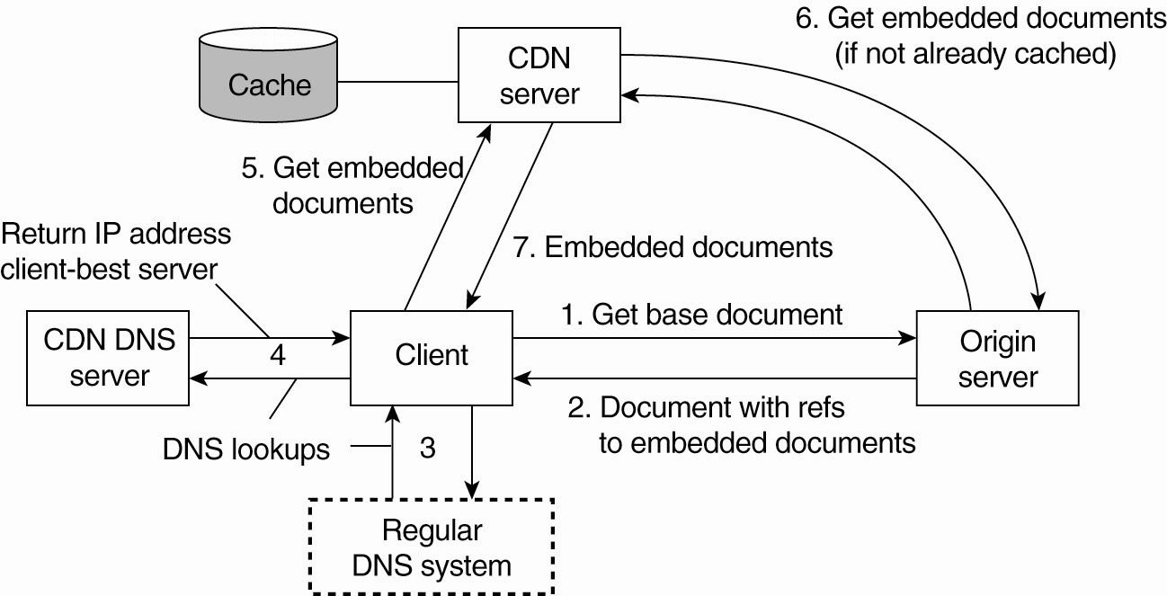
Adjustment Measures
The principal working of the Akamai CDN

Slide 26
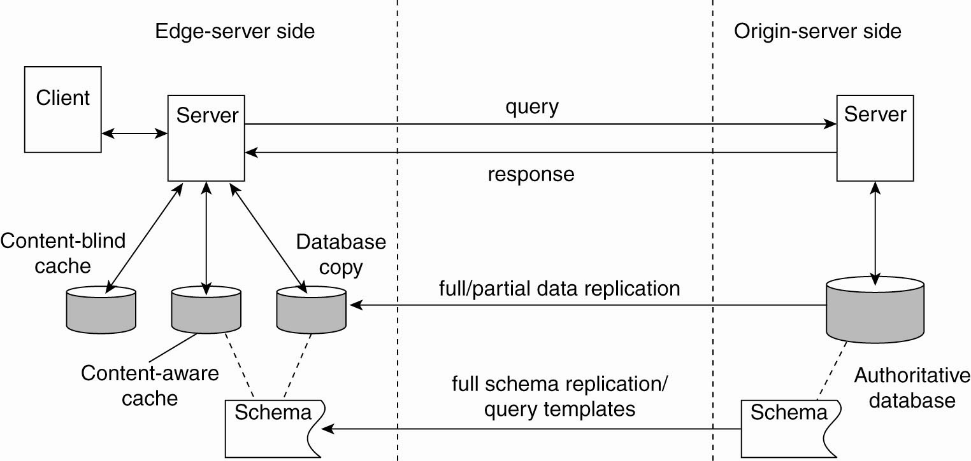
Replication of Web Applications
Alternatives for caching and replication
with Web applications

Slide 27
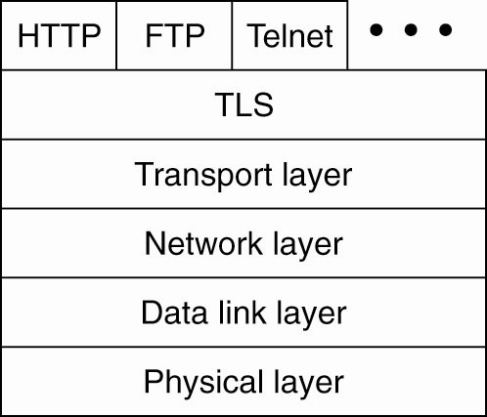
Security (1)
The position of TLS in the Internet protocol stack

Slide 28
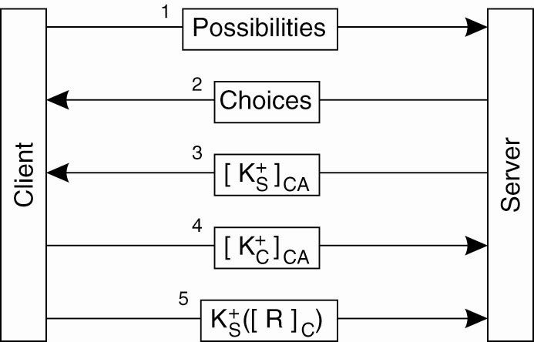
Security (2)
TLS with mutual authentication

